Slide 1
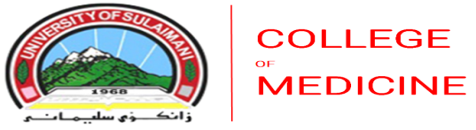
Diseases of the External ear
MUAID ISMAIEL AZIZ BABAN
PROF IN ORL-HNS-SBS
CONSULTANT IN RHINOLOGY-SKULL BASE SURGERY
MBCHB-FICMS-FACS-DOHNS.ED
SULAYMANIYAH UNIVERSITY – COLLEGE OF MEDICINE

Slide 2

Objectives
This lecture outline the different pathology affecting the external ear, focus mainly on the inflammatory condition.

Slide 3
Auricle
Congenital
Trauma
Inflammation
tumors

Slide 4
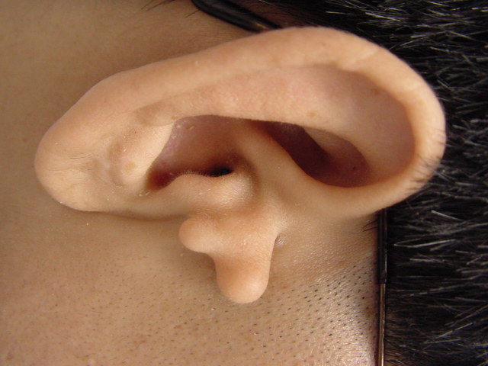
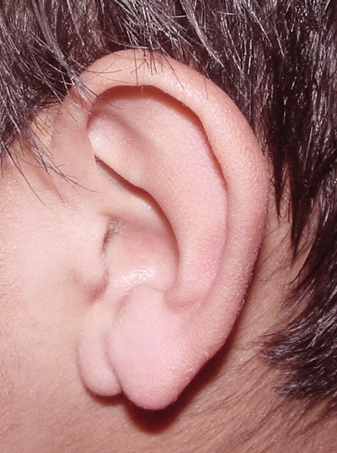
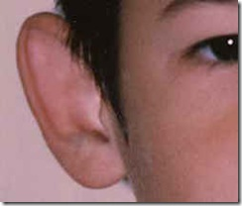
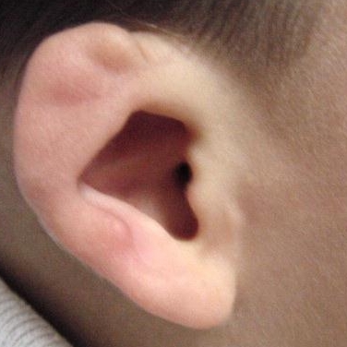
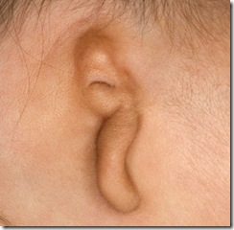

Slide 5
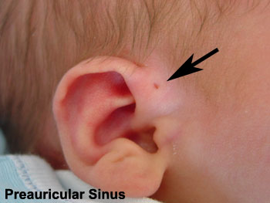

Slide 6
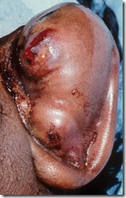
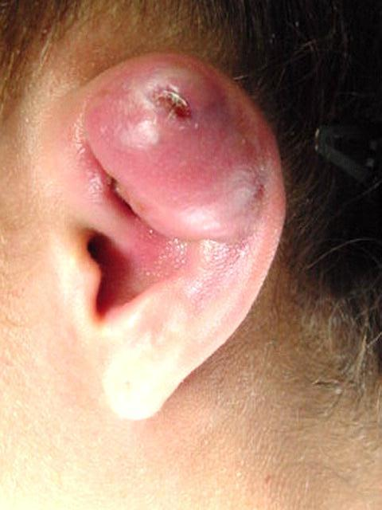
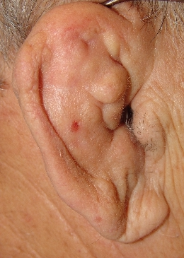
Hematoma

Slide 7
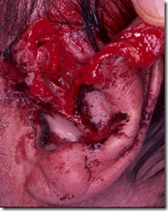
Laceration

Slide 8
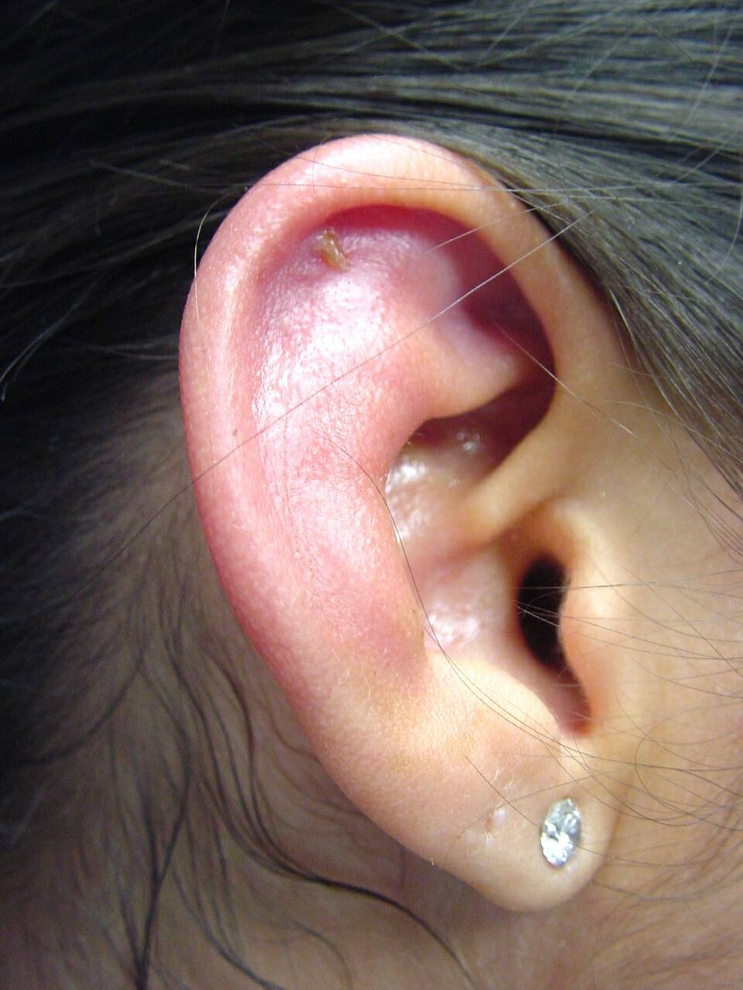
Perichondritis

Slide 9
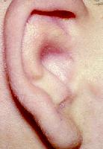
External auditory meatus
Atresia or stenosis
Cong. or acquired

Slide 10
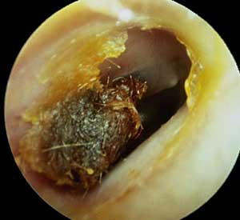
wax
Types , color
Presentation
Treatment

Slide 11
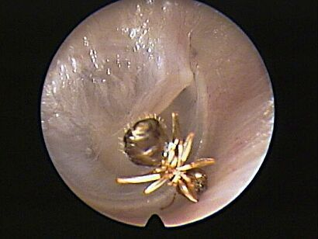
Foreign bodies
Insects
Hard
soft

Slide 12
Otitis externa
Definition
Causes ( 1ry , 2ry )
scratching of the ear with dirty fingers or contaminated objects as matchstick or hair grip , faulty syringing , allergy may be the primary factor.
Types
Microorganisms

Slide 13
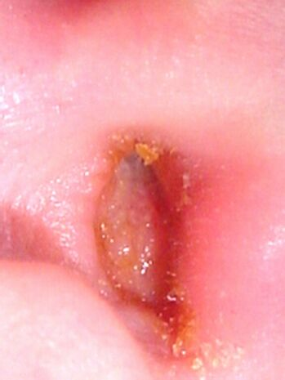
Furunculosis ( boils)
Definition
M.O
Presentation
Pain
Tenderness
Swelling ( ant , post.)
Lymphadenitis
Treatment

Slide 14
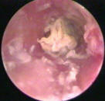
Diffuse otitis externa
Chronic stage
Acute stage
Heat sensation
Sever pain
Discharge
swollen canal skin
CD
Lymphadentitis
Treatment with dry mopping + Ab/steroid
Discharge
Itching
Thickening & narrowing of the canal
Congested granular TM surface
Same + sedation for nocturnal itching
Treatment of both stages generally required thorough & gentle cleansing of external meatus , keeping the ear dry, avoiding trauma by scratching , attention to personal hygiene & treating the associated skin condition .

Slide 15
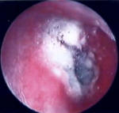
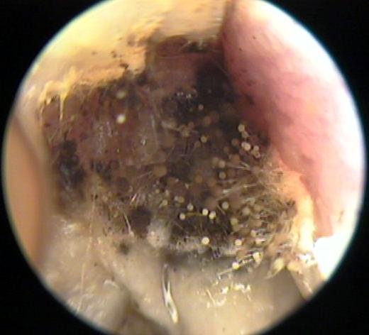
Otomycosis ( fungal infection)
Types
Organism
Presentation
treatment

Slide 16
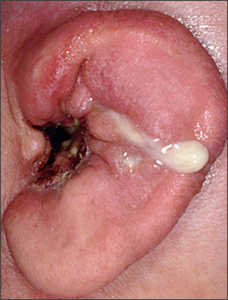
Malignant otitis externa
Skull base osteomyelitis
M.o
Immunocompromised pt
3 stages
Presentation
Treatment
Curetting granulation tissue
daily packing with ribbon gauze impegented with gentamycin ointment
IV antibiotics as 3rd generation cephalosporin , ticarcillin & using oral ciprofloxacin (for 6 wks duration ) is very effective .
Surgery rarely required

Slide 17
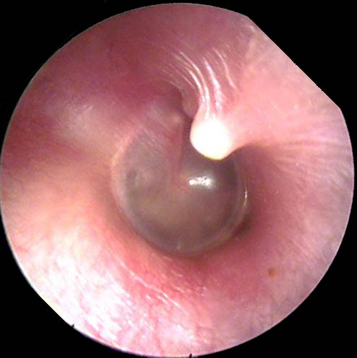
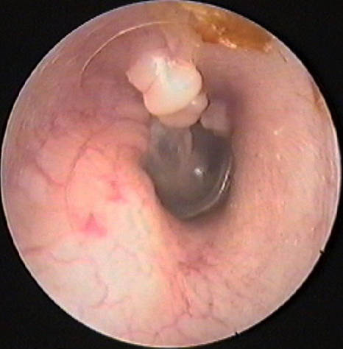
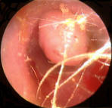
Osteoma
Swimmer ear
Single or multiple exostosis
Conservative or surgery

Slide 18
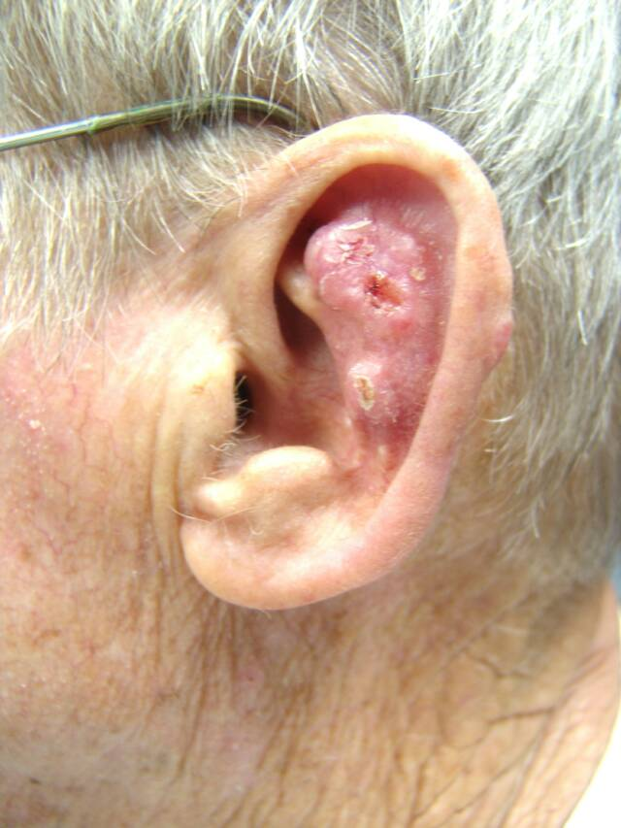
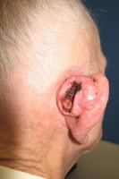
Malignant tumors
BCC
SCC

Slide 19
Conclusions
The commonest inflammatory condition affecting the external ear is diffuse otitis externa, but don’t miss the Malignant otitis externa in immune compromised patients.

Slide 20
References
Scott Brown text book
Logan’s turner text book

